Slide 1
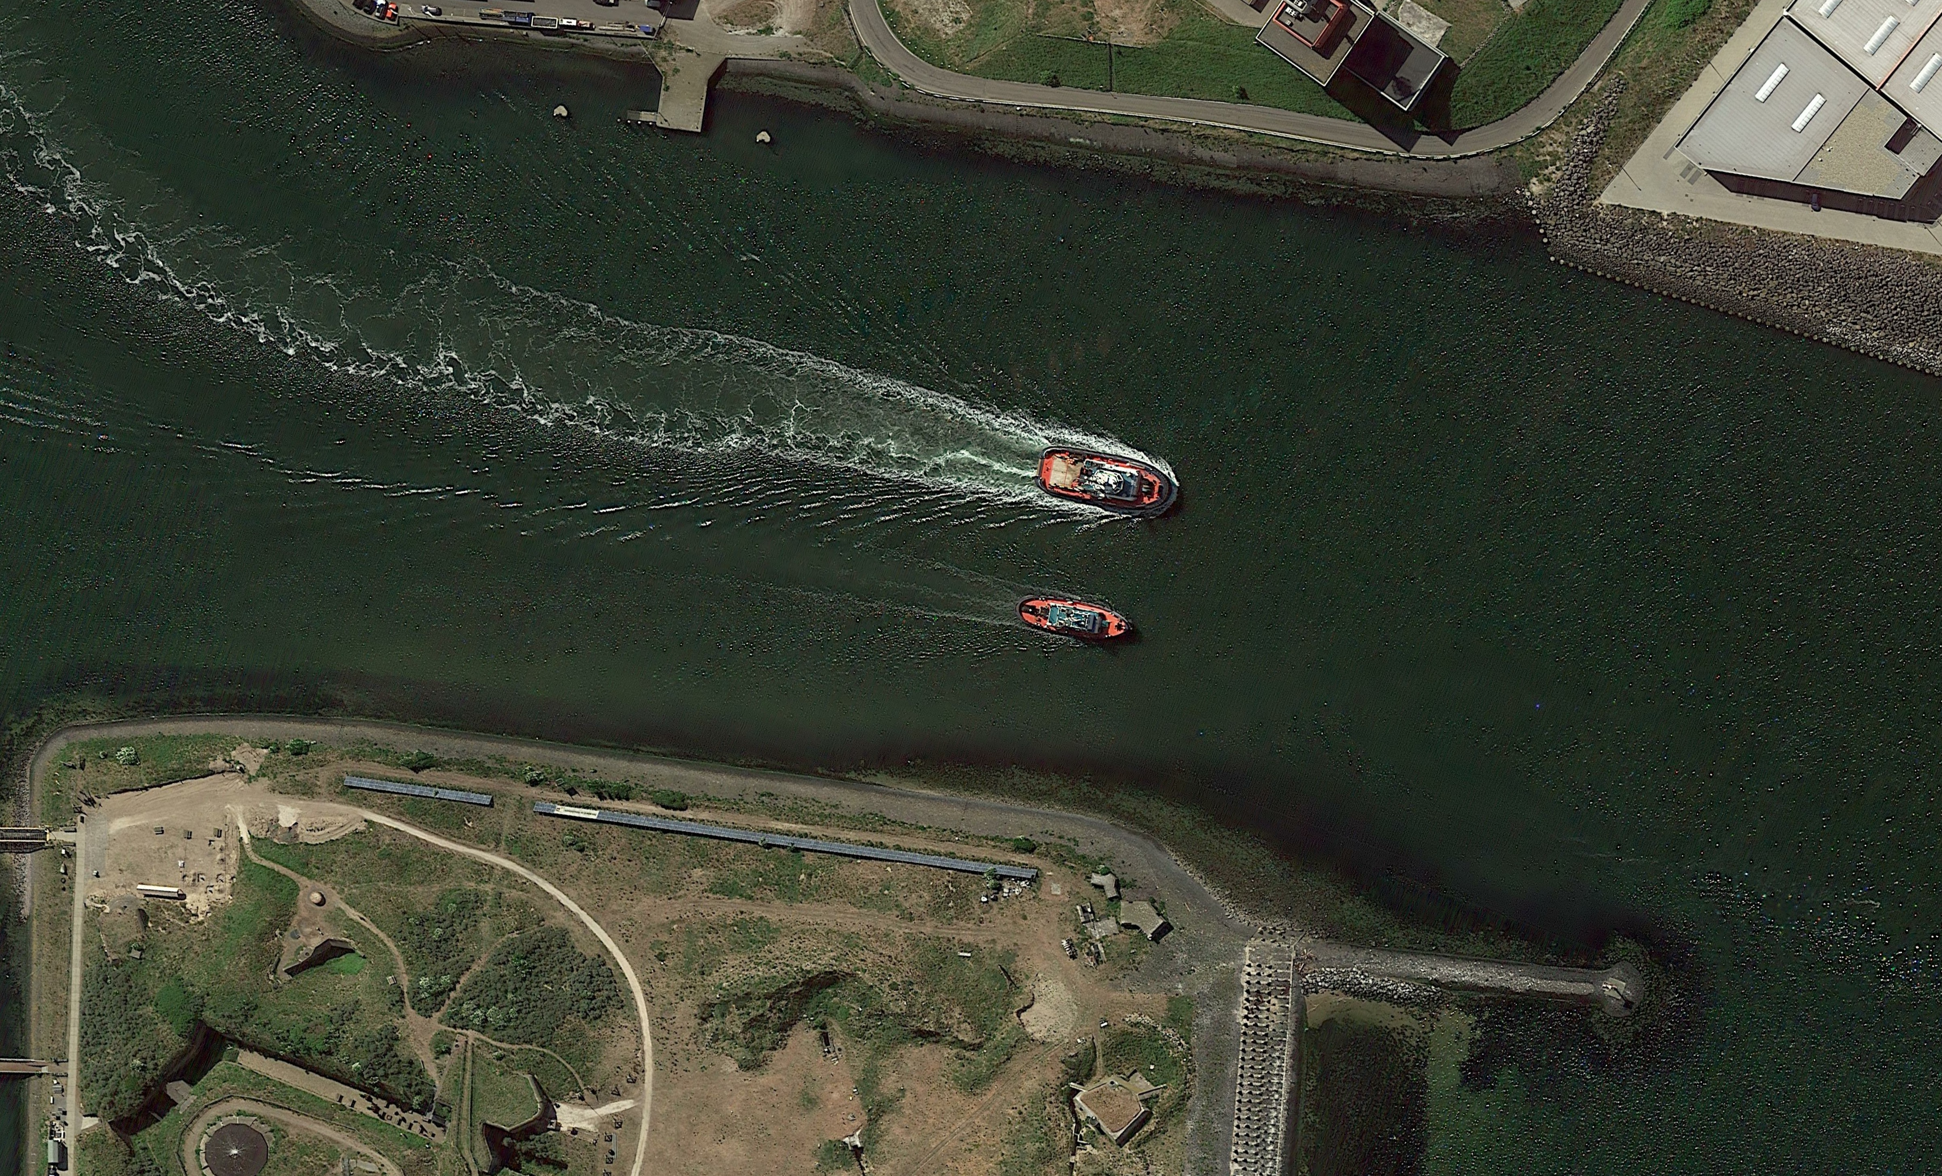
Single class output
Final score (probability of being detected as a boat)
Input image
Convolutional neural network
(CNN)
0.9
Conclusion
It is a boat.

